Slide 1
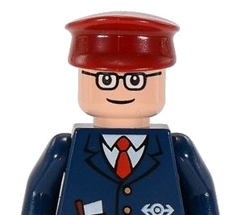
Visible Light Communication
Oliver Ney, Jan Bruckner, Michael Deutschen
Aachen / COMSYS Laboratory, March 2016

Slide 2
Motivation
Visible Light Communication
Communication with visible light (380nm – 780nm)
Advantages
No restrictions to radio bands
Cheap hardware
No known health issues
Disadvantages
Heavy environmental noise
High absorption rates

Slide 3
Motivation – Related Work
[3]

Slide 4
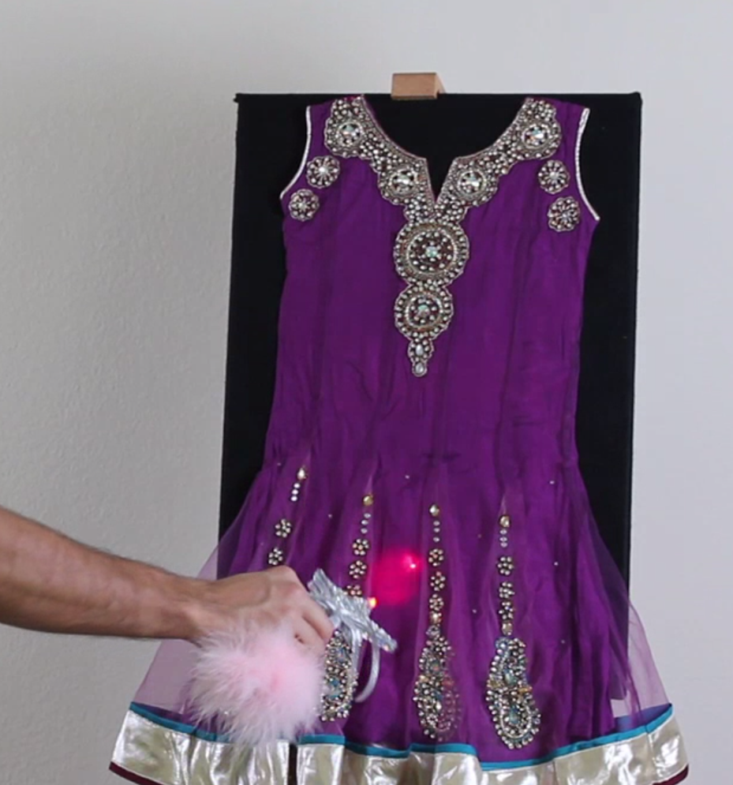
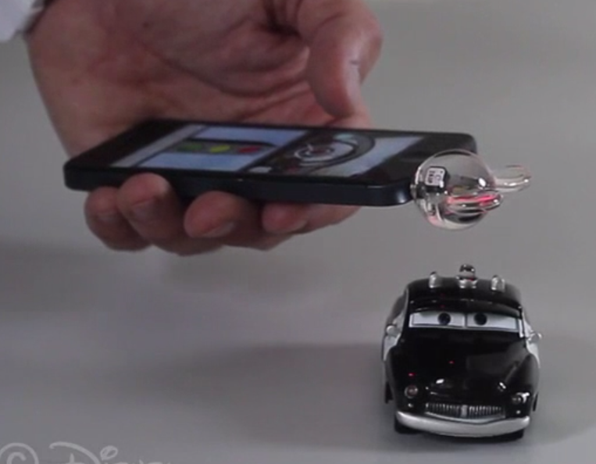
Motivation – Related Work
[3]

Slide 5
Initial Goals
Basic Communication
End-to-end
From Arduino to Arduino
From Smartphone to Arduino
Practical Use Case
Possibly anything
Decided for moving toy train
Controlled by Smartphone via Bluetooth and VLC

Slide 6
Basic Communication
Orientated on OSI model
Bit layer
Hardware control to transceive signals
Responsible for sending single bits
Synchronization
MAC layer
Error detection
Frame separation
Delivery control

Slide 7
Bit Layer
Signal
Idle Pattern
Data Pattern
Equal up- and downtime
Constant level of perceived brightness
Slower than e.g. Manchester coding
00
01
10
11

Slide 8
Bit Layer - Synchronization
Biggest problem in our project!
First variant
Continuous AD conversions of the sensor input
Moving average to remove background noise and to detect edges
Analyzation of each edge on detection
Problems:
conversions caused delays
High number of interrupts blocked program flow
Final variant
With hardware edge detection
Edge triggered interrupt
All edges of a period are stored and analysed afterwards

Slide 9
MAC Layer
16 | 8 | 8 | 0-248 | 8
0xBEEF | Flags + Length | Header CRC | Payload | Payload CRC
Synchronization sequence to delimit frames
Up to 31 byte per frame
Header CRC to validate length
Continuous repetition until the message is acknowledged
Message buffer

Slide 10
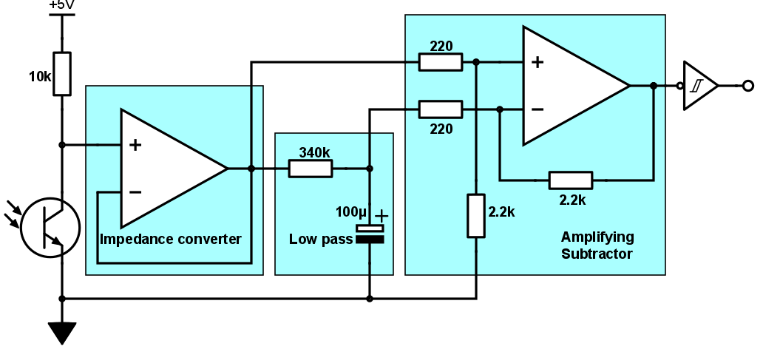
Hardware Edge Detector

Slide 11
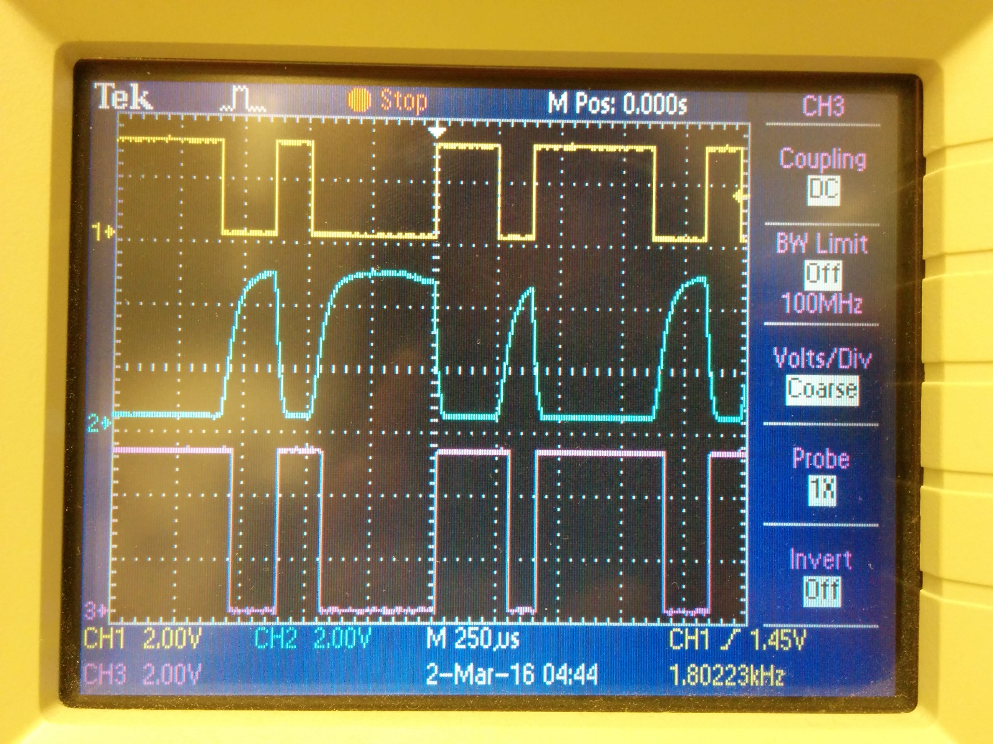
Hardware Edge Detector

Slide 12
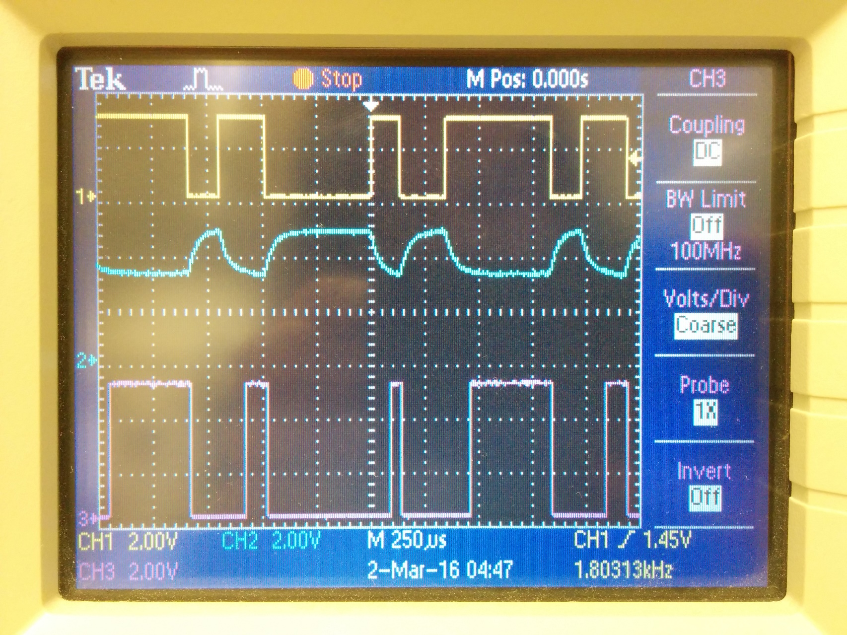
Hardware Edge Detector

Slide 13
Evaluation
Distance: 12 cm

Slide 14
Comparison: DisneyResearch vs. Our VLC
[2]

Slide 15
Comparison: DisneyResearch vs. Our VLC
DisneyResearch
Communication between several devices (CSMA)
LED for sending/receiving fewffdsfsdfsdfsdfdsfsdfdsfsdfdsfdsfsdfsdfsdfsdfsdff
Continuous AD conversion
Our VLC
Communication between 2 Arduinos
LED for sending, phototransistors for receiving
Hardware edge detector

Slide 16
Use Case
Control a LEGO train with VLC
App communicates with a track controller via Bluetooth
Control turnout, speed, direction, headlights and taillights
Track controller communicates with train via VLC
Signal along the track transmits data

Slide 17
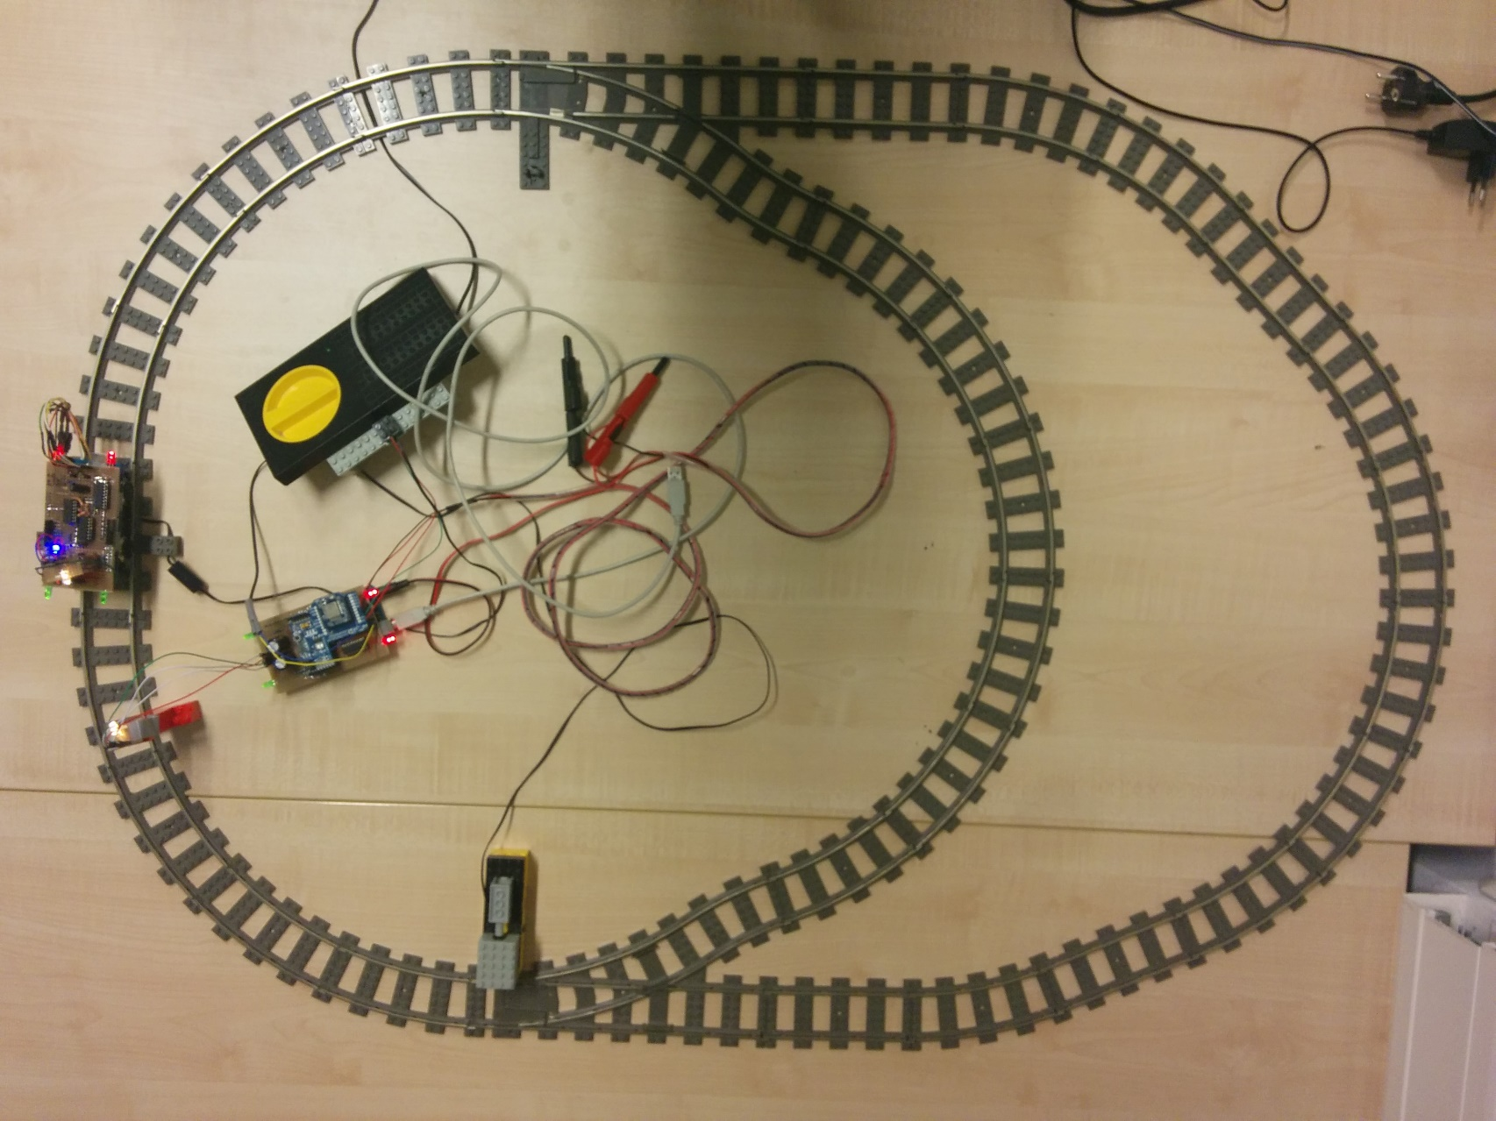
Use Case

Slide 18
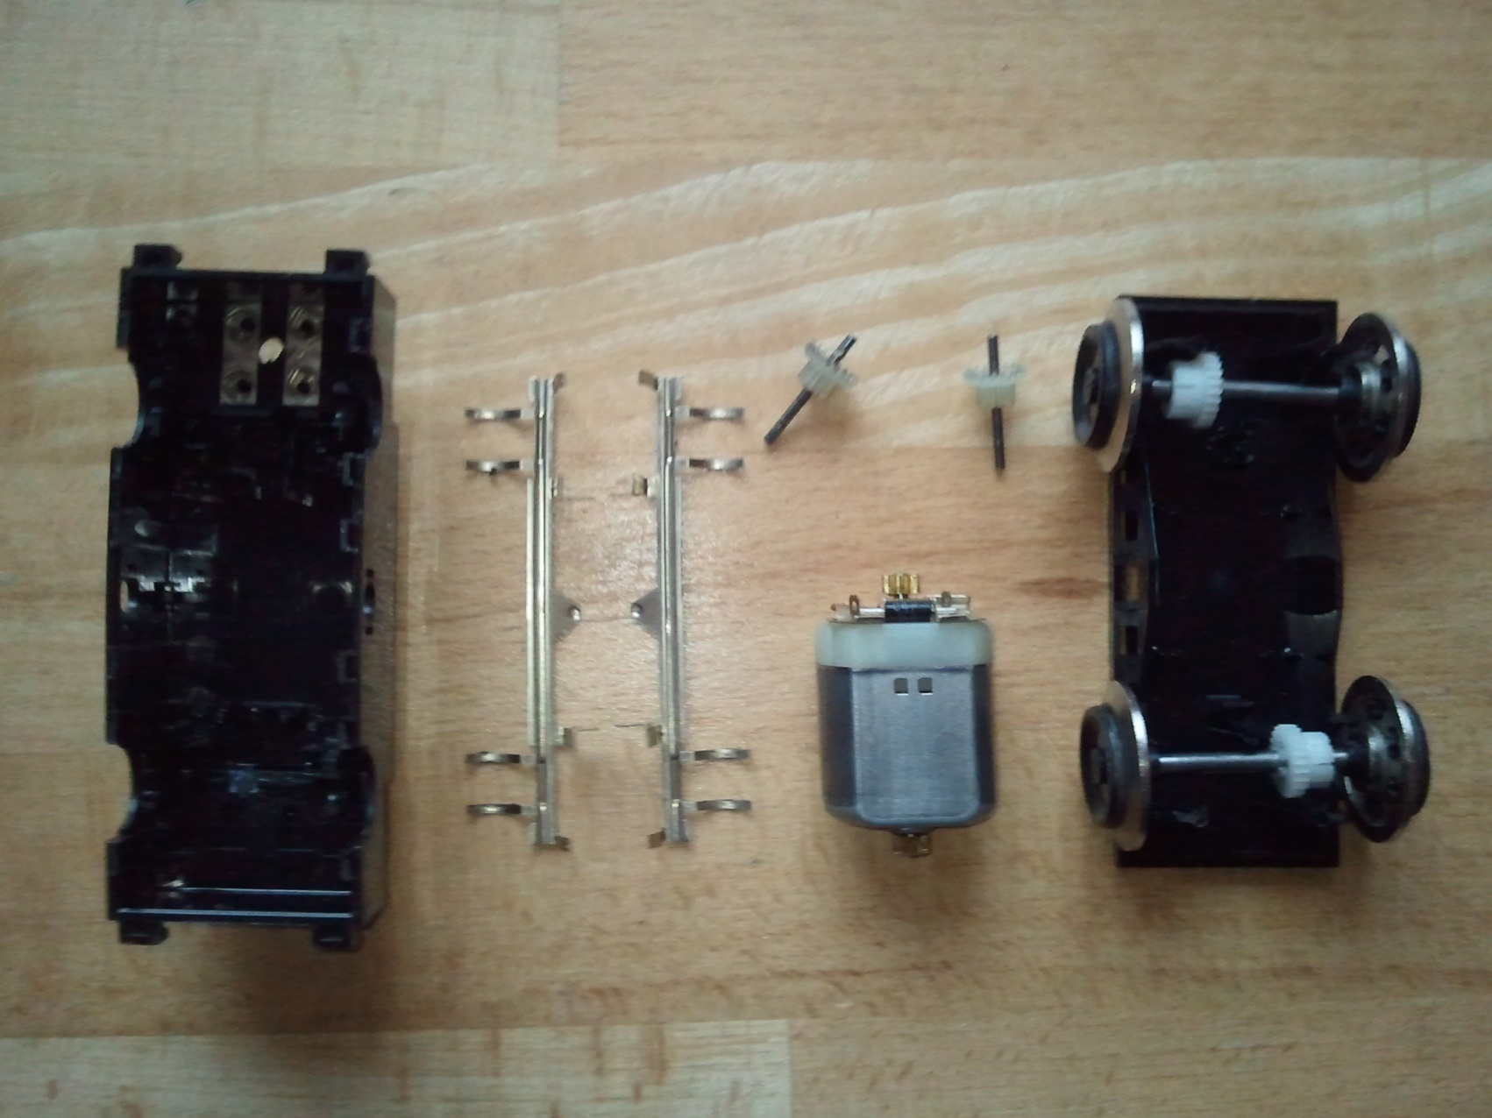
Hardware

Slide 19
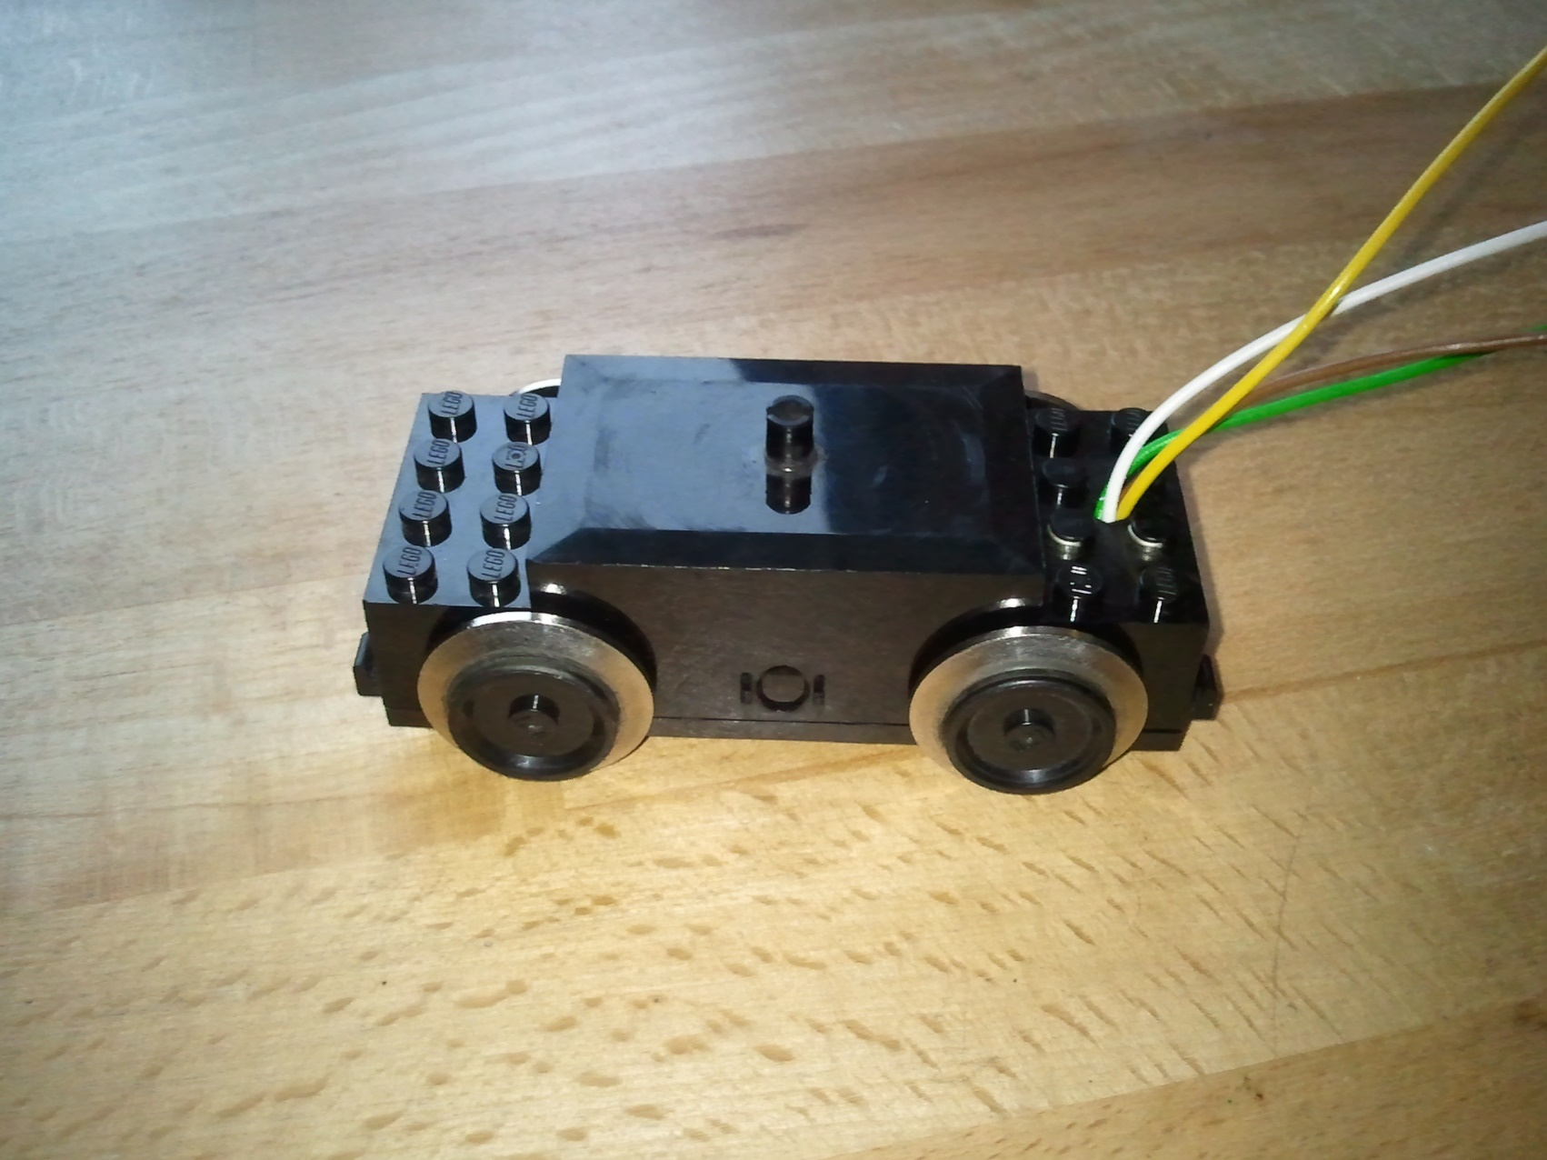
Hardware

Slide 20
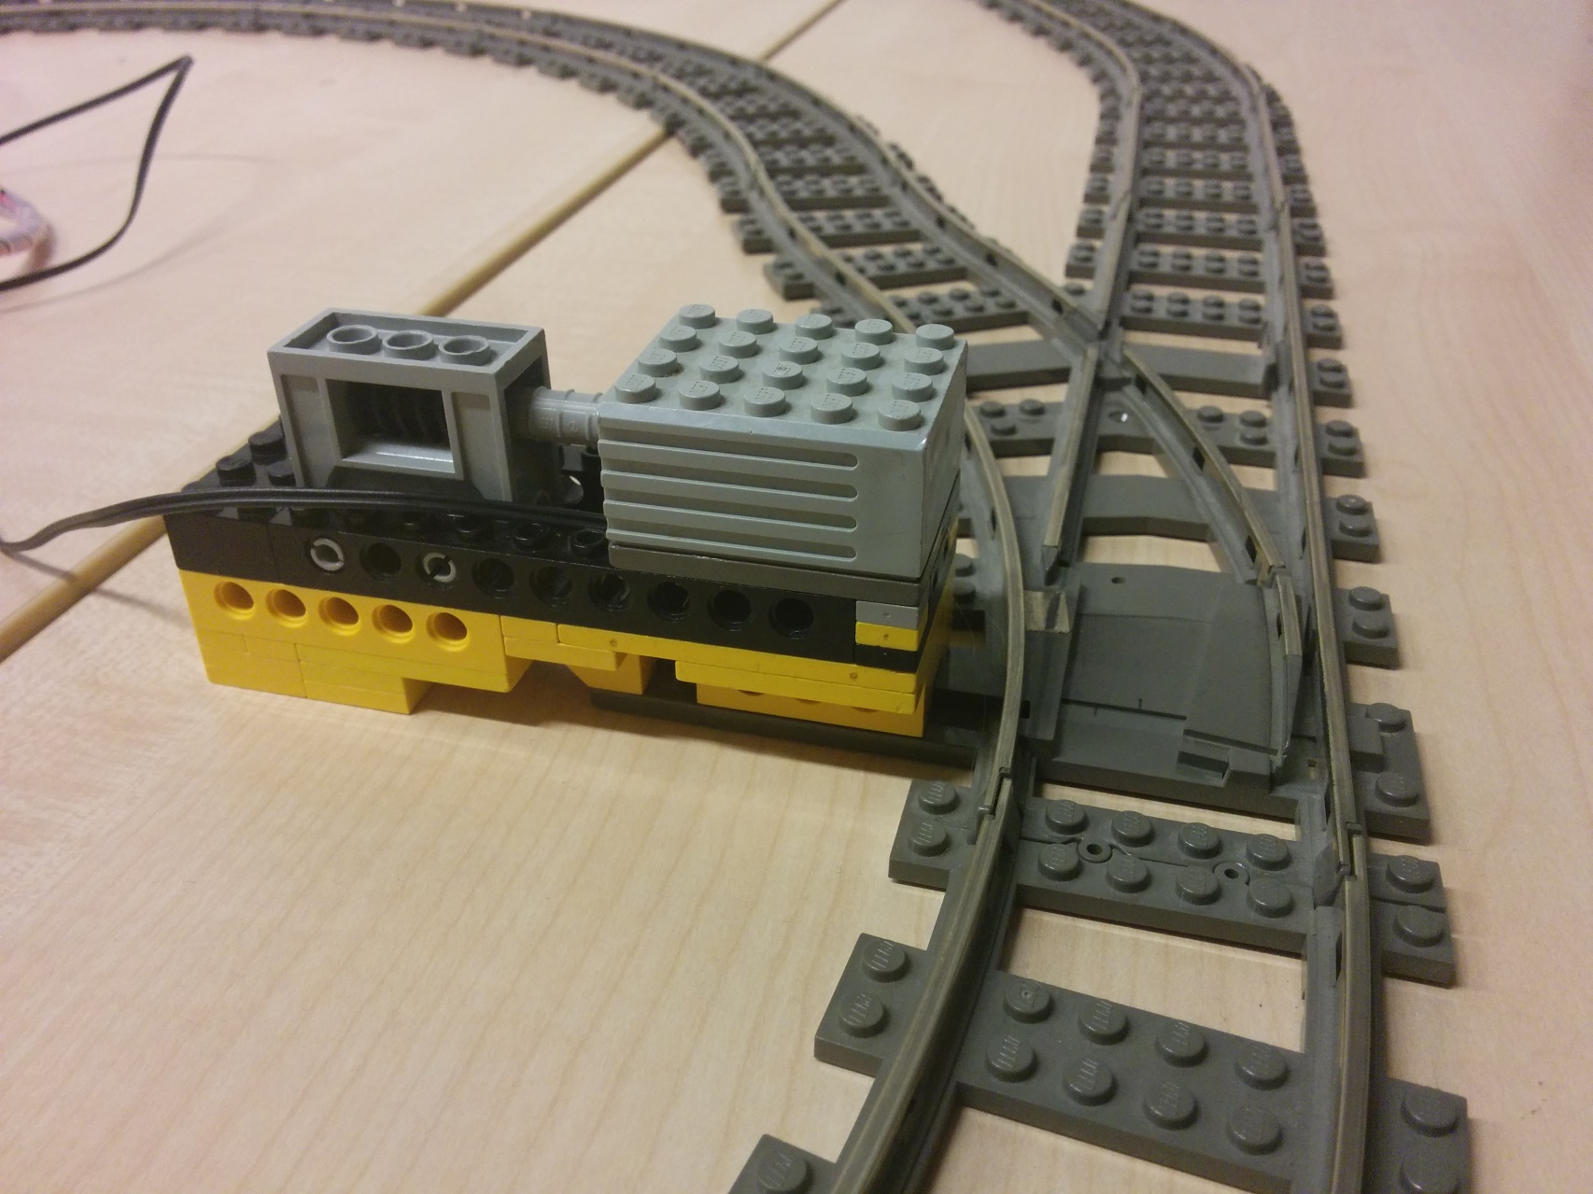
Hardware

Slide 21
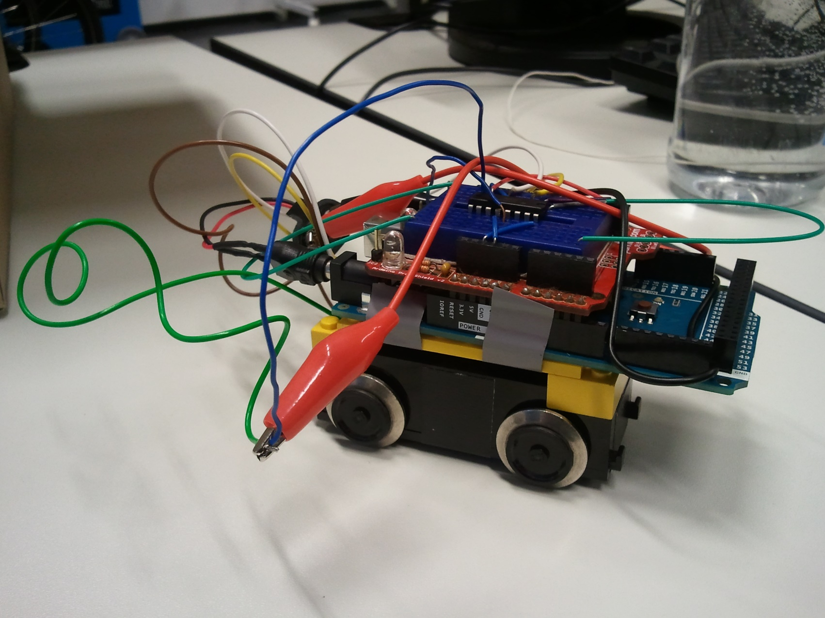
Evolution of the Train

Slide 22
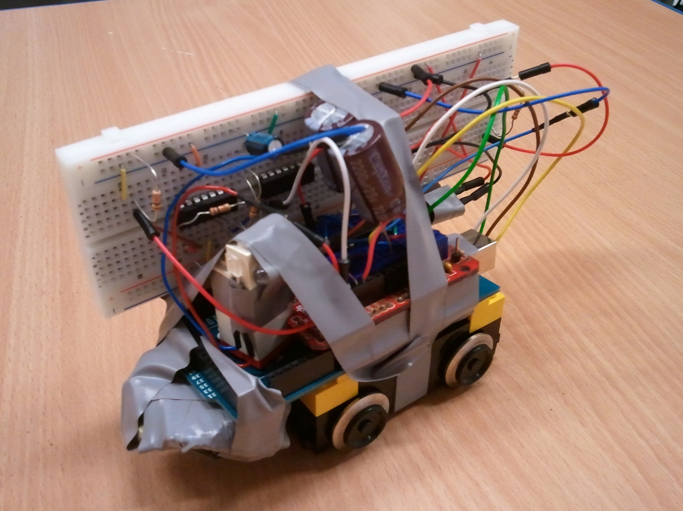
Evolution of the Train

Slide 23
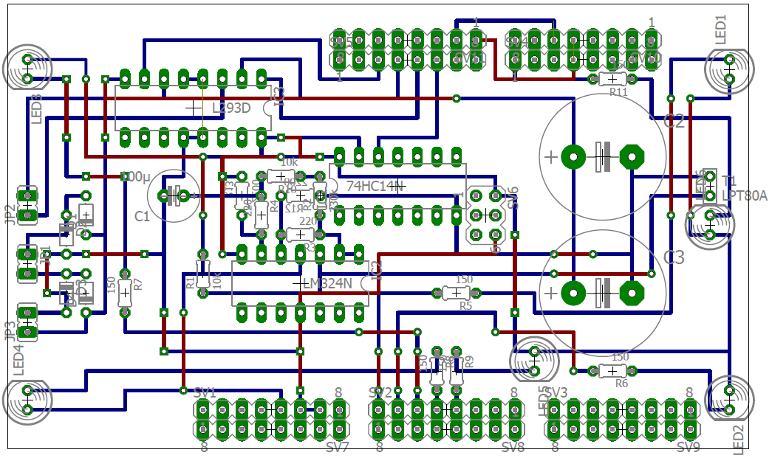
Evolution of the Train

Slide 24
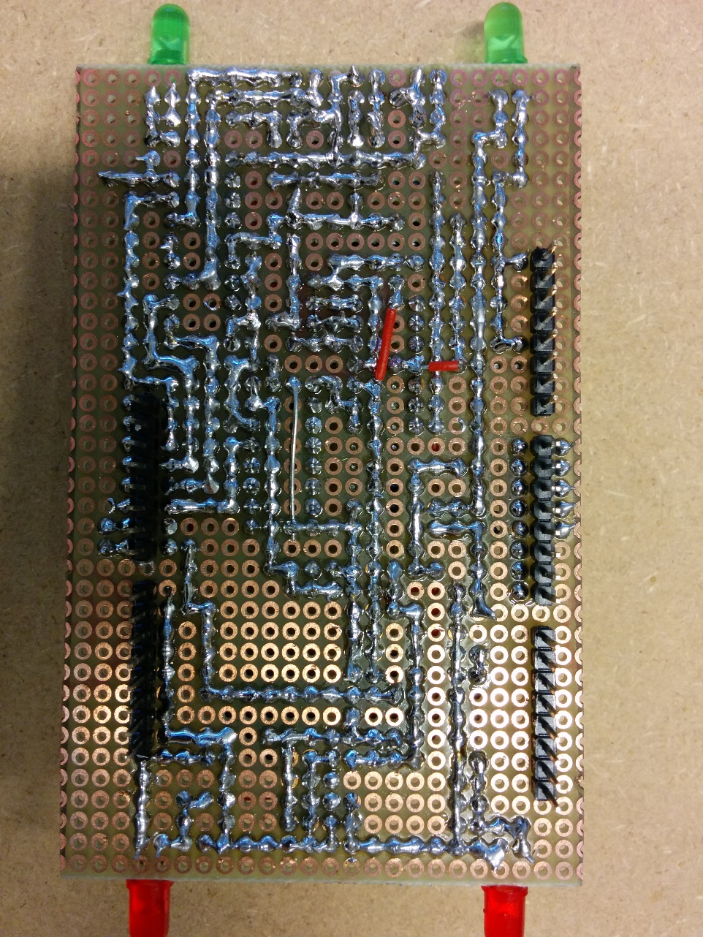
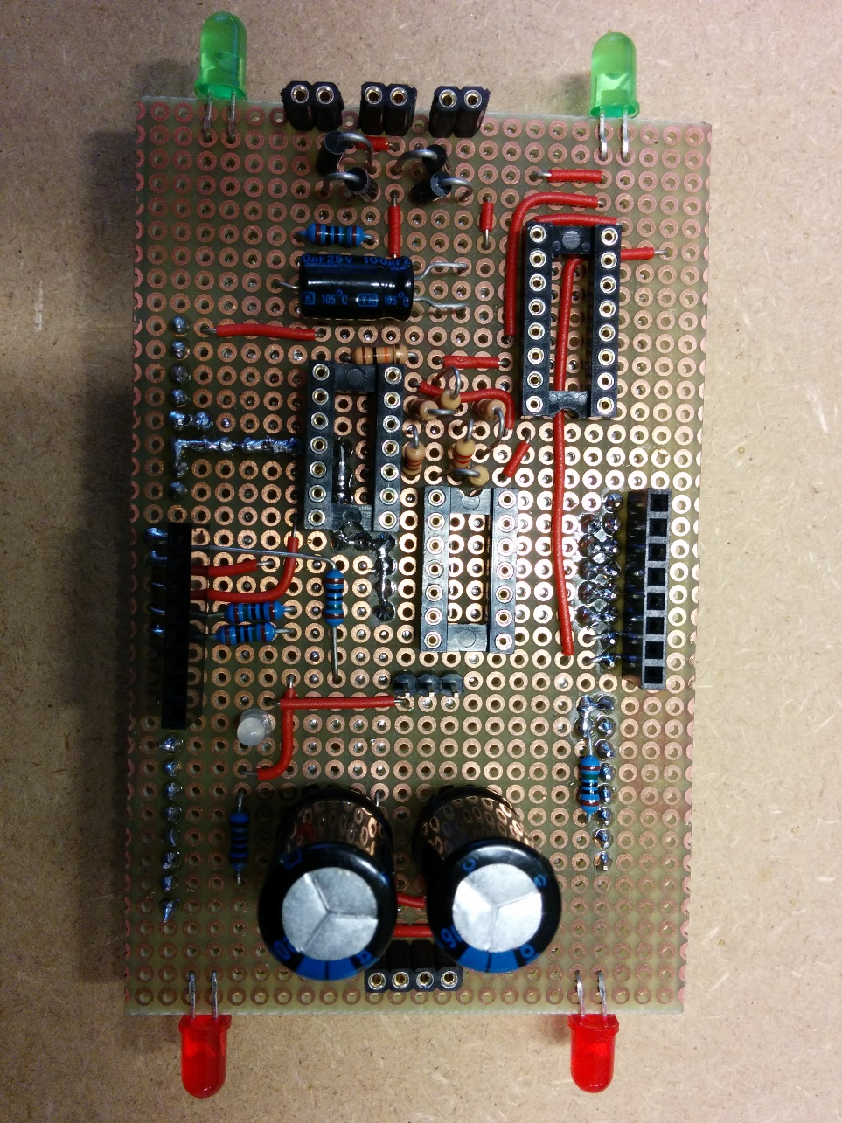
Evolution of the Train

Slide 25
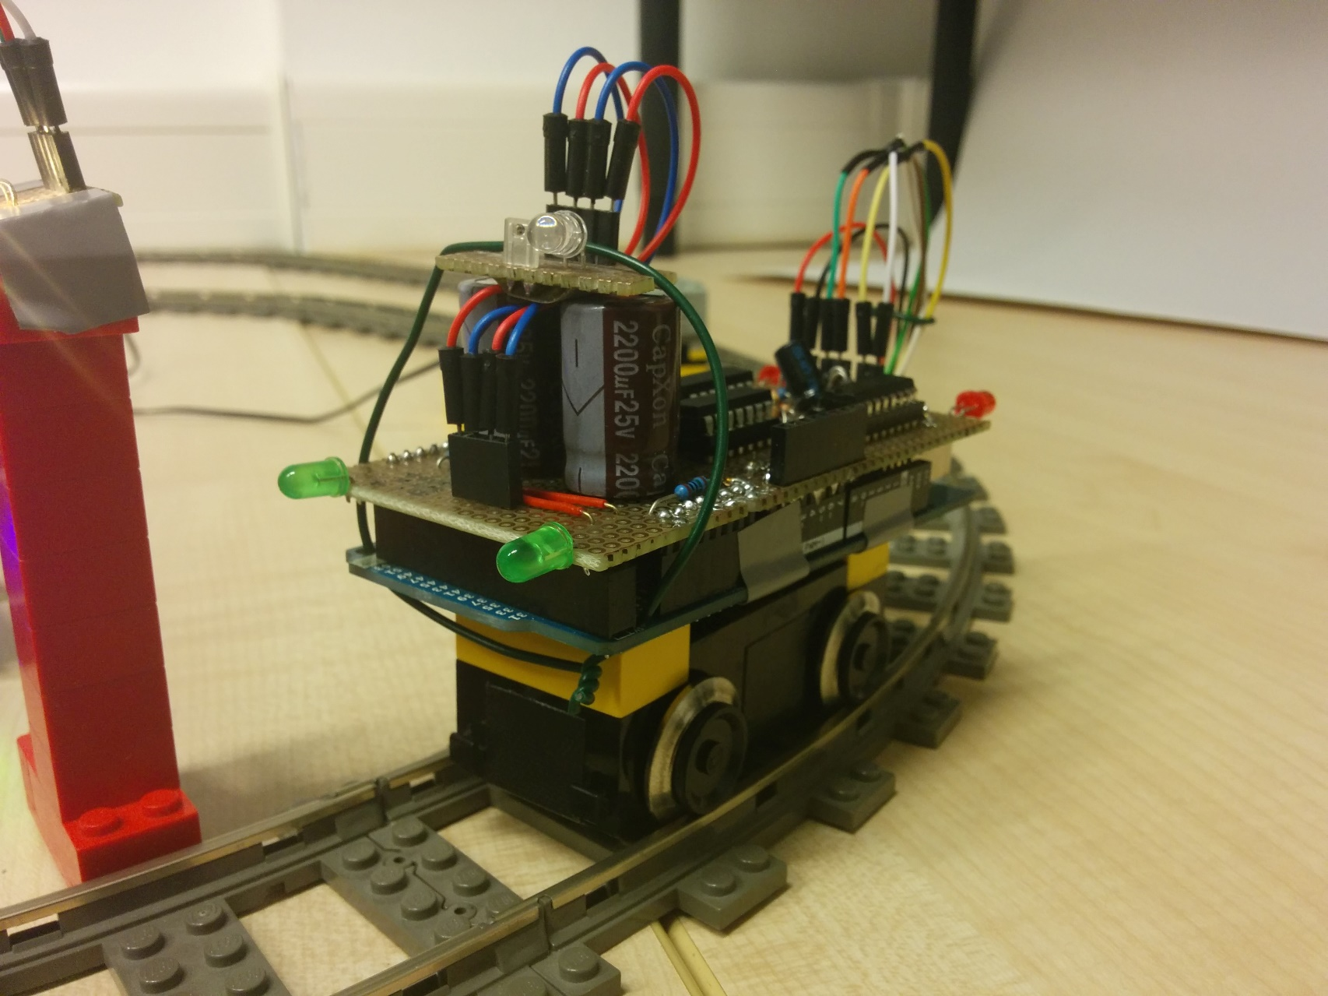
Evolution of the Train

Slide 26
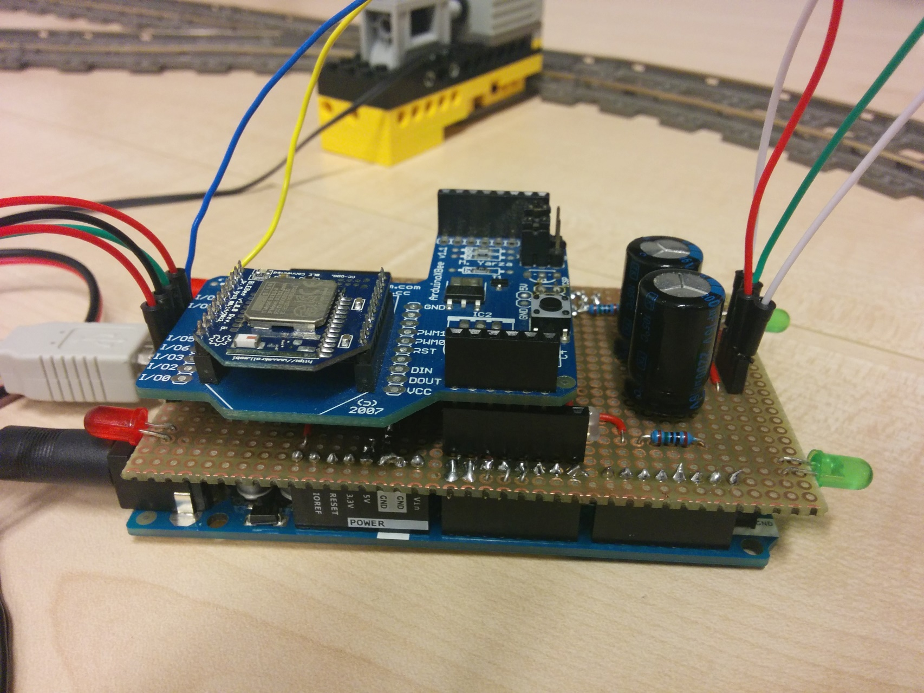
Final Track Controller

Slide 27
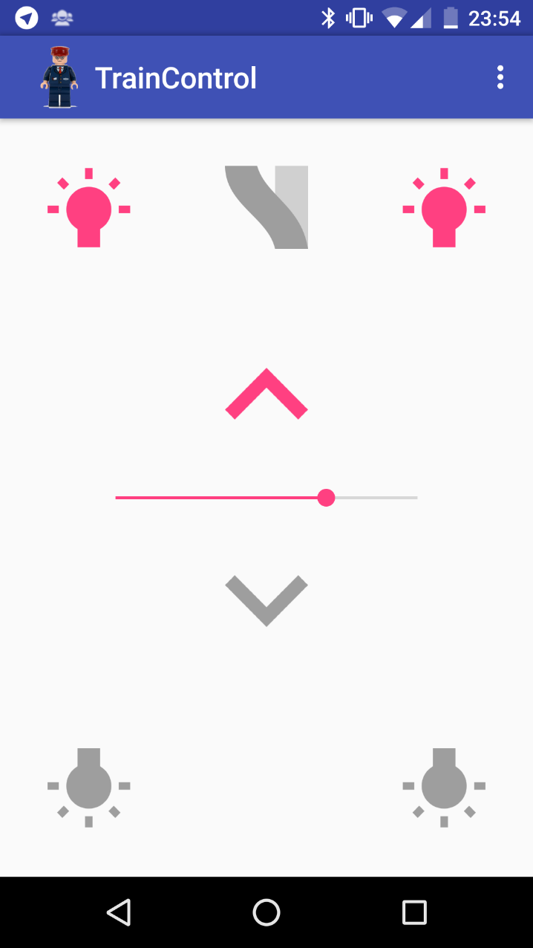
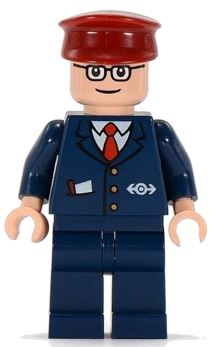
App - TrainControl

Slide 28
Demonstration

Slide 29
Sources
Subway Train Conductor. http://lego.wikia.com/wiki/Subway_Train_Conductor
Stefan Schmid, Giorgio Corbellini, Stefan Mangold, and Thomas R. Gross. 2013. LED-to-LED visible light communication networks. In Proceedings of the fourteenth ACM international symposium on Mobile ad hoc networking and computing (MobiHoc '13). ACM, New York, NY, USA, Pages 1-10.
Visible Light Communication. https://www.disneyresearch.com/project/visible-light-communication/

